Slide 1





Automating Emergency Department Governance with R
robinmarlow
Dr Robin Marlow
@robindmarlow
robin.marlow@uhbw.nhs.uk
Notes:
Hello My name is Robin & I’m a Children’s Emergency Medicine Consultant.
My day job is looking after sick and injured children, but I’m also the governance lead for our department.
That means I need to look at our metrics to understand if we are performing well.
I want to take you on a journey of how I’ve been using R to make my life easier.
I’m not an R novice, I very first used it in X but only really started in a big way during my PhD.
You’ll all have heard of the 4hr target as a the big measure introduced in the 90s to encourage flow through departments.
Whilst there is some debate, in general this was felt to have been a good thing.
In recent years however we have all been struggling to meet this target and there has been discussion about what it should be replaced by.
We don’t have a dedicated analyst in our department or even division. In fact my understanding is the BI isn’t really for helping solve clinical queries.
We do have access to dashboards which are good at answering specific queries but not helping you unpick the cause.
Like this one.
Post COVID our big problem has been crowding, we are simply overwhelmed.
We started out by trying to unpick where our children were coming from with this Sankey Diagram.
To do this BI created a search which would tell us for each patient where they came from and their outcome.
I then condensed this in R. Sadly I couldn’t get the graphics to look as nice in R so exported it in a way to import into this website.
But that was the start, with a page that would give me data on each attendance in a time period, I started asking for more fields to be added until today where I have 43 variables for each visit.
I found that I could use R to directly read this

Slide 2
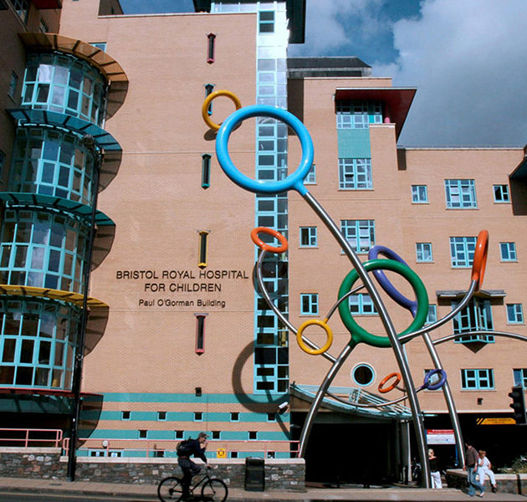


Slide 3


Slide 4
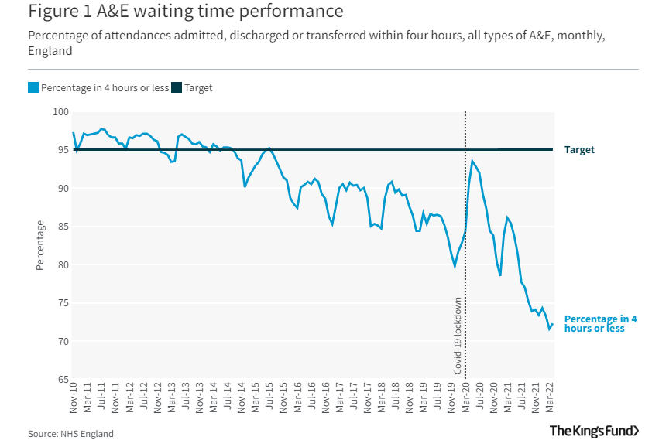
https://www.kingsfund.org.uk/projects/urgent-emergency-care/urgent-and-emergency-care-mythbusters

Slide 5
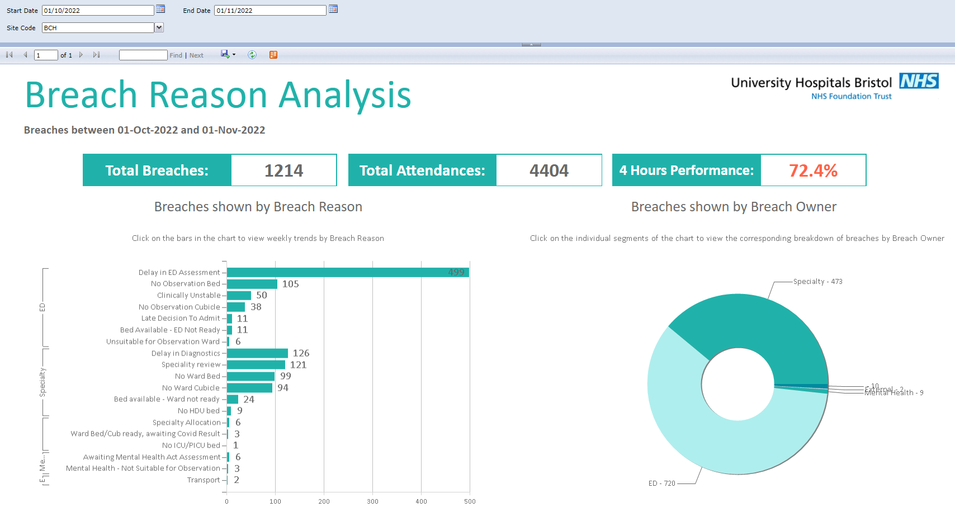


Slide 6


Slide 7
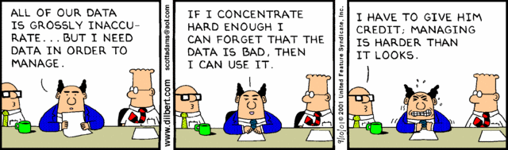

Slide 8


Slide 9

Increasing attendances

Slide 10


Increasing attendances
Departmental crowding

Slide 11

Increasing attendances
Departmental crowding
Exit block

Slide 12
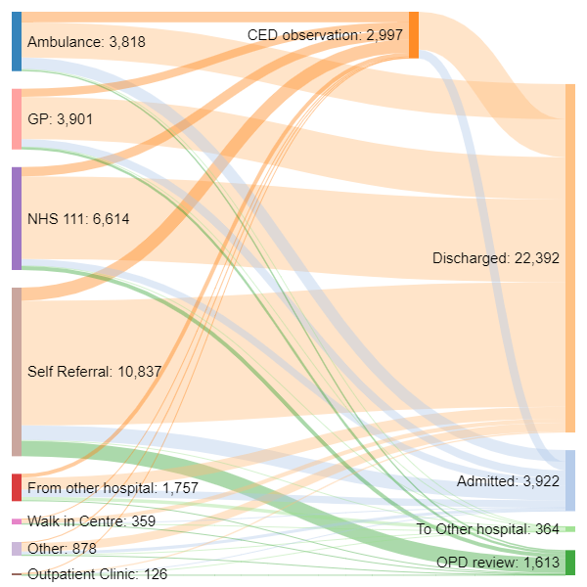
https://sankeymatic.com/

Slide 13
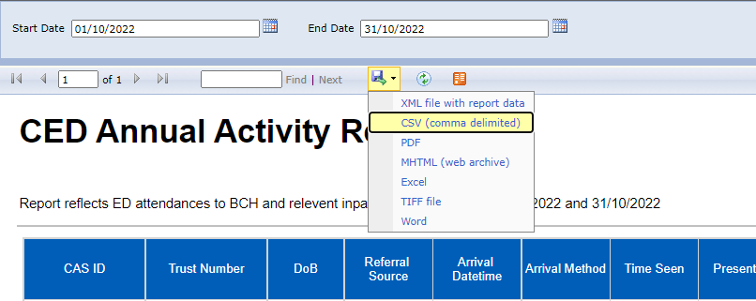

Slide 14
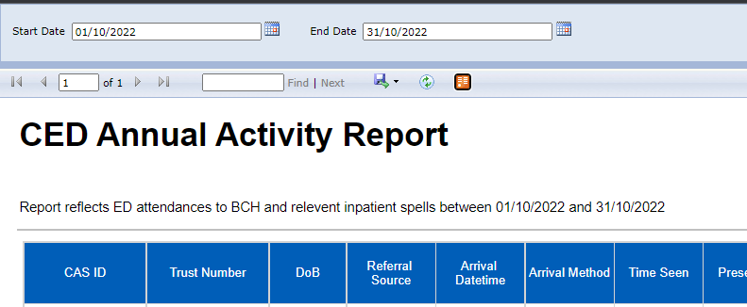
<?xml version="1.0" encoding="utf-8" standalone="yes"?>
<service xmlns:atom="http://www.w3.org/2005/Atom" xmlns:app="http://www.w3.org/2007/app" xmlns="http://www.w3.org/2007/app">
<workspace><atom:title>CED_Annual_Report</atom:title>
<collection href="http://bireports.ubht.nhs.uk/HDMSQL?%2FUHBristol%20Reports%2FCore%20Team%2FAd%20Hoc%20Requests%2FPID%2FCED_Annual_Report&amp;Staff=UBHT_NT%5CMarlowR&amp;ReportName=CED_Annual_Report&amp;freq_default=Master%20Load&amp;red_alert=%23CC0000&amp;amber_alert=%23FF6600&amp;StartDate=10%2F01%2F2022%2000%3A00%3A00&amp;EndDate=10%2F31%2F2022%2000%3A00%3A00&amp;rs%3AParameterLanguage=&amp;rs%3ACommand=Render&amp;rs%3AFormat=ATOM&amp;rc%3AItemPath=Tablix1">
<atom:title>Tablix1</atom:title>
</collection></workspace></service>

Slide 15
<?xml version="1.0" encoding="utf-8" standalone="yes"?>
<service xmlns:atom="http://www.w3.org/2005/Atom" xmlns:app="http://www.w3.org/2007/app" xmlns="http://www.w3.org/2007/app">
<workspace><atom:title>CED_Annual_Report</atom:title>
<collection href="http://bireports.ubht.nhs.uk/HDMSQL?%2FUHBristol%20Reports%2FCore%20Team%2FAd%20Hoc%20Requests%2FPID%2FCED_Annual_Report&amp;Staff=UBHT_NT%5CMarlowR&amp;ReportName=CED_Annual_Report&amp;freq_default=Master%20Load&amp;red_alert=%23CC0000&amp;amber_alert=%23FF6600&amp;StartDate=10%2F01%2F2022%2000%3A00%3A00&amp;EndDate=10%2F31%2F2022%2000%3A00%3A00&amp;rs%3AParameterLanguage=&amp;rs%3ACommand=Render&amp;rs%3AFormat=ATOM&amp;rc%3AItemPath=Tablix1">
<atom:title>Tablix1</atom:title>
</collection></workspace></service>

Slide 16

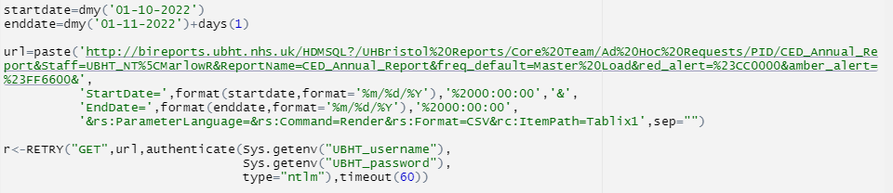

Slide 17
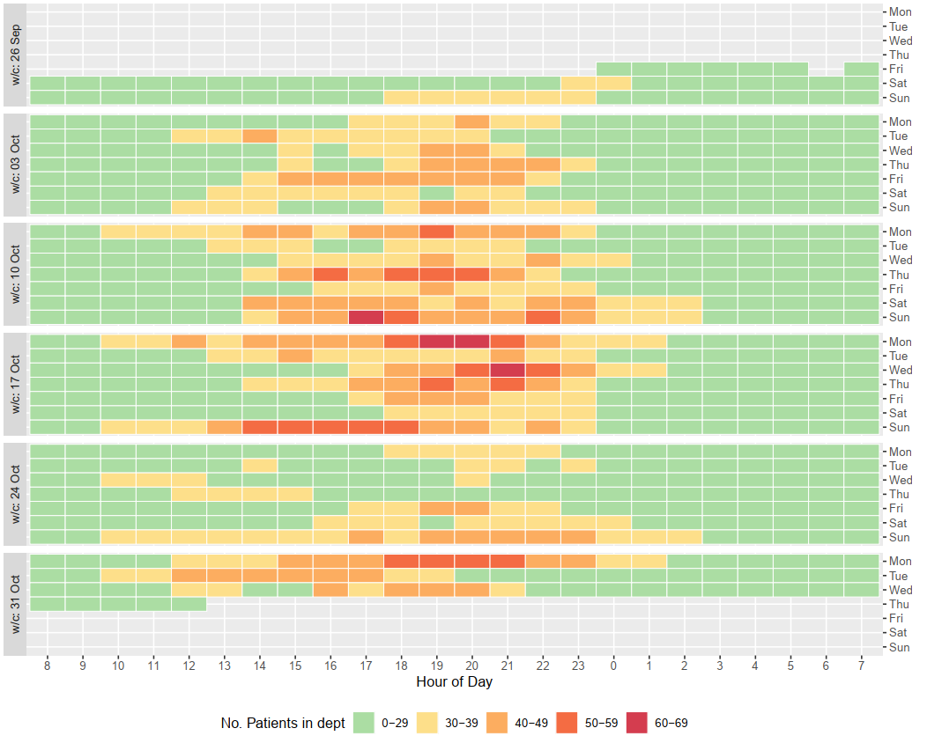
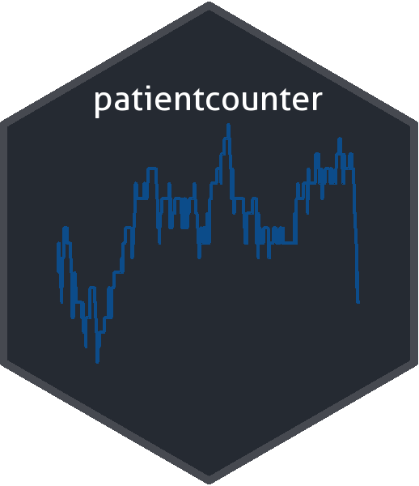
Number of patients in department
https://github.com/johnmackintosh/patientcounter

Slide 18
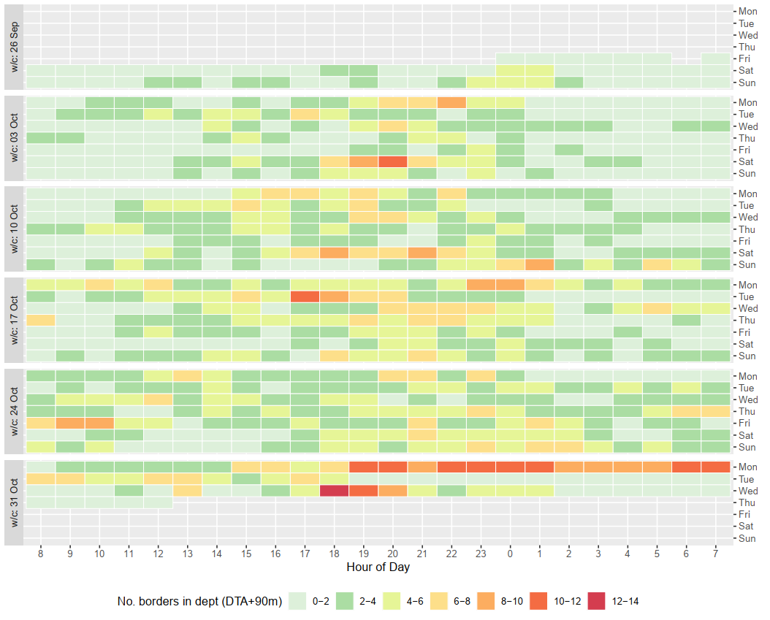
Number of patients waiting for a bed

Slide 19
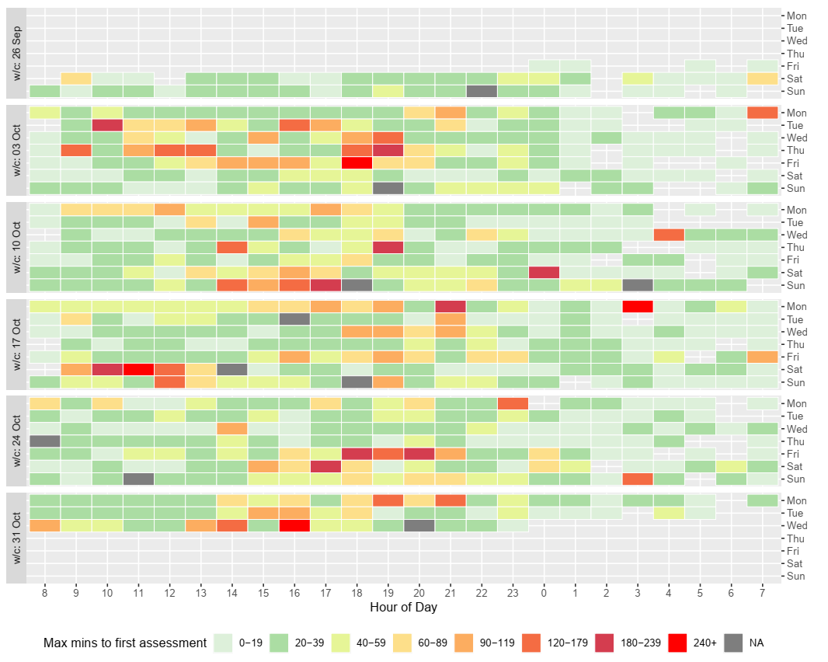
Max time to initial assessment

Slide 20


Slide 21


Slide 22



Slide 23



R
+
?

Slide 24
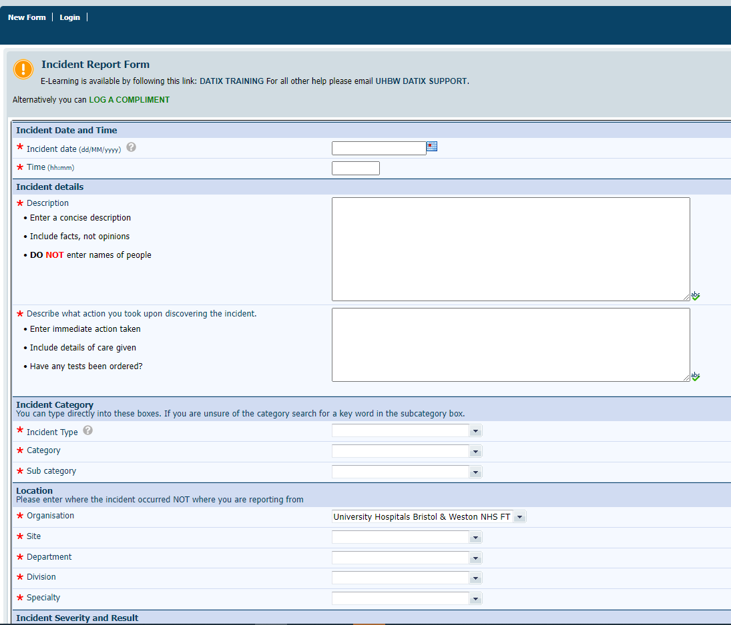
R
+
?

Slide 25


Slide 26
DR’s
Amateur Analysis

Slide 27

DR’s
Amateur Analysis

Slide 28

GIVE A MAN A FISH AND YOU FEED HIM FOR A DAY, TEACH A MAN TO FISH AND YOU FEED HIM FOR A LIFETIME

Slide 29
GIVE A CLINICIAN A BI REPORT AND YOU FEED HIS NEEDS FOR A DAY, GIVE HIM ACCESS TO DATA AND YOU FEED HIS NEEDS FOR A LIFETIME

Slide 30




Thanks to:
Alex Berki – Improvement analyst
Darren Groble – IT systems

Slide 31

Questions? / Suggestions!
robinmarlow
@robindmarlow
robin.marlow@uhbw.nhs.uk
https://github.com/robinmarlow/CED_performance

